Slide 1


K.RAMAKRISHNAN COLLEGE OF TECHNOLOGY
(AUTONOMOUS), TRICHY
MAZE SOLVER
PRESENTED BY
2303811710621083- A.RAHAMATHULLA

Slide 2
PROBLEM IDENTIFICATION
1.Incorrect Pathfinding: The solver might not always find the optimal path or could get stuck in loops.
2.Performance: The solver might take too long to find a solution, especially for large or complex mazes
3.Memory Usage: If the solver uses memory inefficiently, it could lead to crashes or slow performance
4.Handling Obstacles: Difficulty navigating around obstacles or dead ends could be a problem4.
2/7/20

Slide 3
OBJECTIVE
Developing an efficient maze solver algorithm to navigate through complex mazes, optimizing for speed and accuracy."
"Design and implement an efficient algorithm for solving mazes, aiming to find the shortest path from the entrance to the exit while minimizing computational resources and maximizing accuracy."

Slide 4
IMPLEMENTATION METHODLOGY
MODULE DESCRIPTION
"A maze solver algorithm demonstrates the virtue of perseverance as it tirelessly navigates through obstacles to find the optimal path
It embodies the ethical principle of problem-solving, striving to overcome challenges and achieve a goal while respecting constraints and boundaries."

Slide 5
PYTHON LIBRARY FUNCTIONS USED
1. NumPy: Useful for efficient numerical operations and representing the maze as a 2D array. 2.Matplotlib: Helps in visualizing the maze and the path found by the algorithm. 3.Queue (from collections): Used for implementing breadth-first search (BFS) or depth-first search (DFS) algorithms. 4.Heapq (from heapq):Useful for implementing Dijkstra's algorithm or A* search algorithm for finding the shortest path in the maze. 5. **Copy**: For creating deep copies of data structures, which can be helpful in backtracking algorithms. These libraries provide essential functionality to efficiently implement and visualize maze solving algorithms in Python.

Slide 6
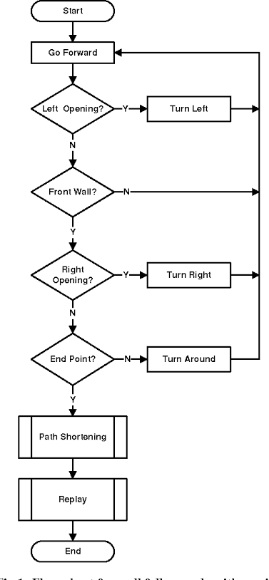
FLOW DIAGRAM

Slide 7
HARDWARE AND SOFTWARE REQUIREMENTS
Software Requirements: 1.Programming Language
Hardware Requirements: 1. Computer or Microcontroller
2.RAM
2.Algorithm implementation
3.Dead End Check
4. Repeat
3.Maze Representation
5. Exit Found
4.Sensor/Device Interface

Slide 8
IMPLEMENTATION LEVEL
Input/Output Module:
Manages interaction with the user interface or external systems for inputting maze data and displaying the solved path.
Maze Representation Module:
Responsible for loading, storing, and representing the maze structure.Provides methods for accessing maze elements, checking walls or obstacles, and retrieving start and end points.

Slide 9
THANK YOU

